Slide 1


DIABETIC PATIENTS’ READMISSION PREDICTION
Group - 8

Slide 2
Business Problem
To identify the factors that lead to the high readmission rate of diabetic patients within 30 days post discharge and to correspondingly predict the high-risk diabetic patients who are most likely to get readmitted.
Also, to identify the medicines that are the most effective in the treatment.
Why the problem need to be addressed?
Diabetes Mellitus (DM) is a chronic disease where the blood has high sugar level. It is a progressive disease that can lead to a significant number of health complications and profoundly reduce the quality of life.
Hospital readmission is a high-priority health care quality measure and target for cost reduction. The burden of diabetes among hospitalized patients, however, is substantial, growing, and costly, and readmissions contribute a significant portion of this burden.
Thirty-day readmission rates for hospitalized patients with DM are reported to be between 14.4 and 22.7% much higher than the rate for all hospitalized patients (8.5–13.5%).

Slide 3
Data Set Overview
The data subset used for analysis covers 10 years of diabetic patients encounters data (1999 – 2008) with over 100,000 diabetic patients and 50 variables including length of stay, medicines, in-patient visits etc. from 130 hospitals in the United States.
Patient identifiers :- encounter_id, patient_nbr
Patient demographics :- race, gender, age, weight ,payer_code
Admission and Discharge details :- admission_source_id ,admission_type_id, discharge_disposition_id
Patient medical history :- number_outpatient ,number_inpatient, number_emergency
Patient Admission details :- medical_speacialty ,diag_1, diag_2 and diag_3, time_in_hospital, number_diagnoses, num_lab_procedures, num_procedures, num_medications
Clinical Results :- max_glu_serum, A1cresult
Medication Details :- diabetesMed, change, 23 features for medications
Readmission Indicator : - readmitted
Variable Types :– Cat:36, Num:13, Bool:1

Slide 4
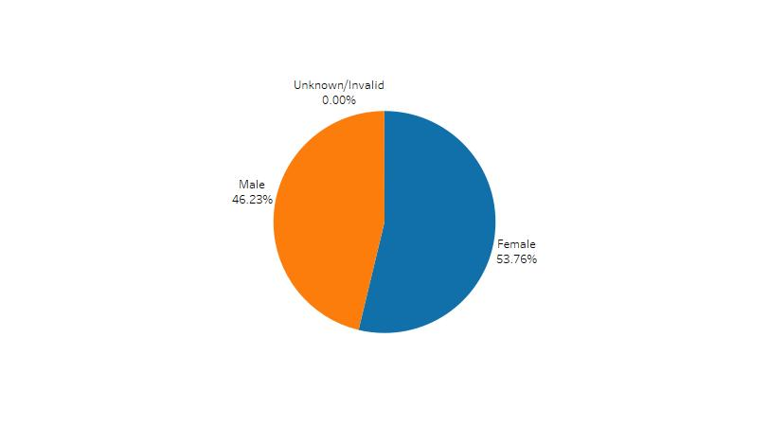
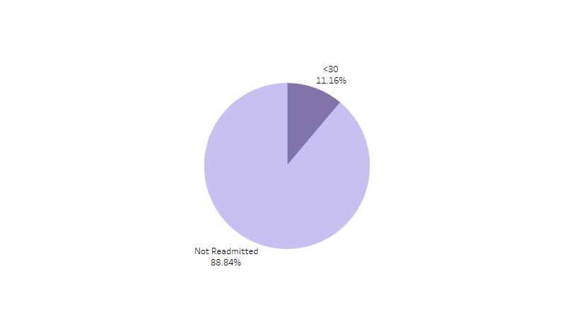
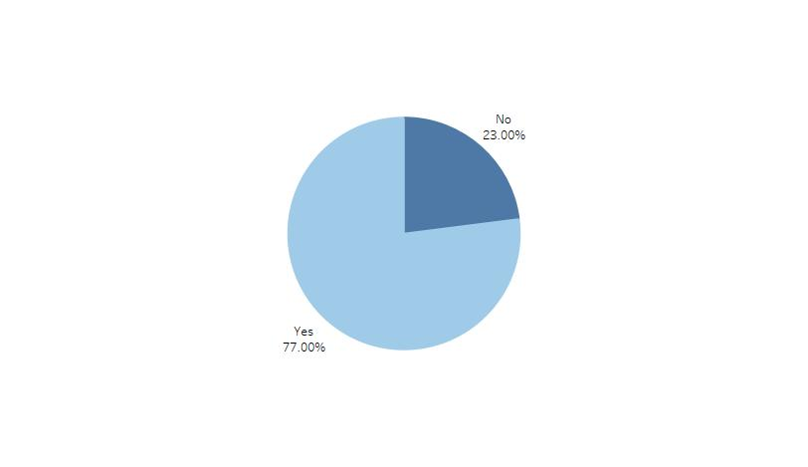



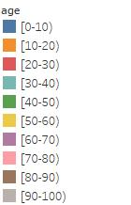
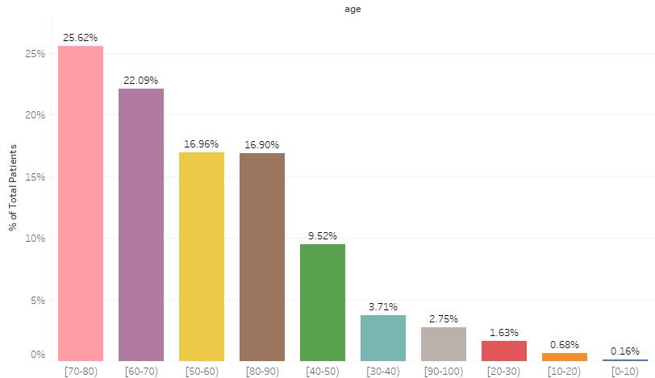
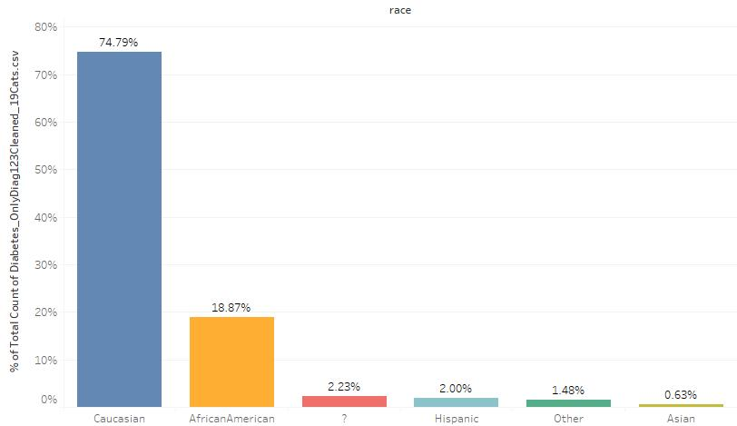
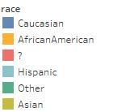
Exploratory Data Analysis
Fig i. Diabetes Med Univariate
Fig ii. Gender Univariate
Fig iii. Readmission Univariate
Fig iv. Age Univariate
Fig v. Race Univariate
% Count of Patients
% Count of Patients
Age
Race

Slide 5
Inferences on Univariate Analysis:
Diabetes Med Univariate: Diabetes Med , 77.00% takes medicines and 23.00% are not taking diabetes medicines.
Gender Univariate : 46.23% are male and 53.76% are females.
Readmission Univariate: Readmission (Target Variable) , 11.16% people are readmitted within 30 days and 88.84% people are not admitted or admitted after 30 days.
The outcome actually has < 30, > 30 and No Readmission categories.So wrt our problem we will convert this into 2 categories i.e No readmission or readmission with in 30 days
Age Univariate : Age shows the % count of patients with respect to age.
The age group 70-80 have high percentage of total patients and age group 0-10 have lowest.
Race Univariate , Caucasian have highest percentage count of patients i.e 74.79% and Asian have lowest i.e 0.63%

Slide 6
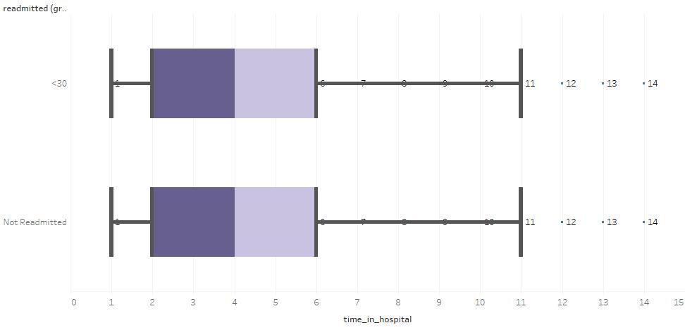
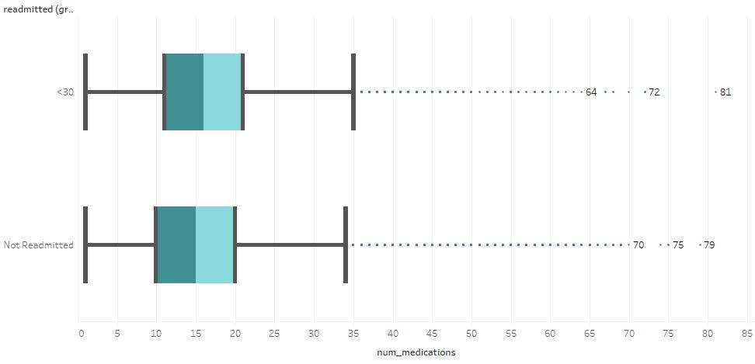
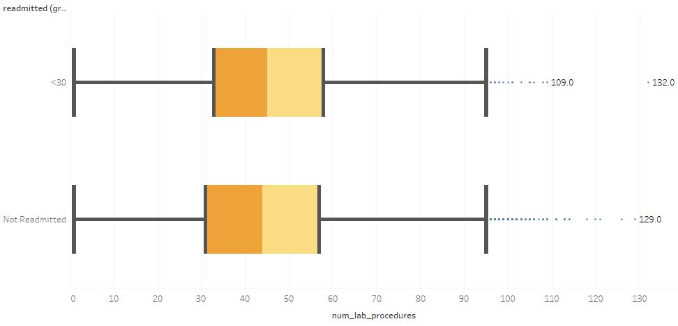
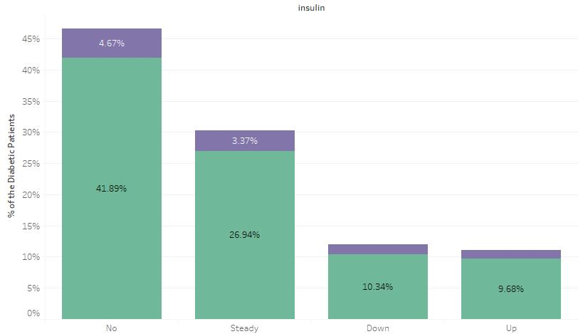
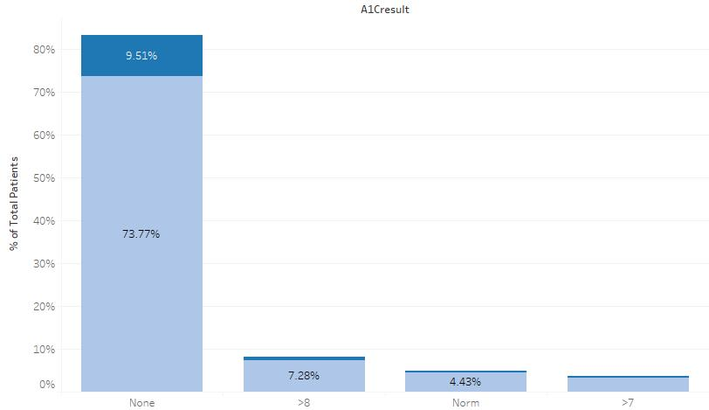
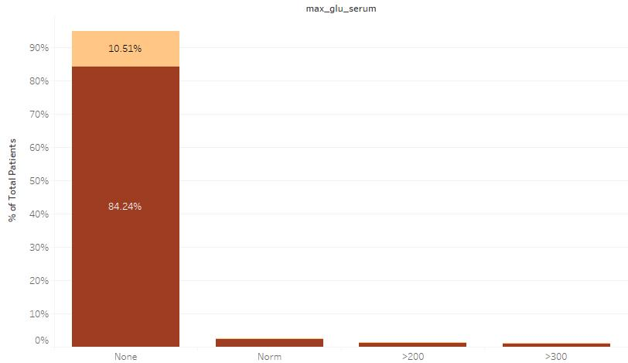




Fig vi. Time vs Readmission
Fig vii. No. of Medication vs Readmission
Fig viii. Lab Procedures vs Readmission
Readmitted
Not
Readmitted
Fig ix. Insulin vs Readmission
Fig x. A1c Result vs Readmission
Fig xi. Max Glucose Serum vs
Readmission
% Count of Patients
Insulin
A1C Result
Max Glu Serum

Slide 7
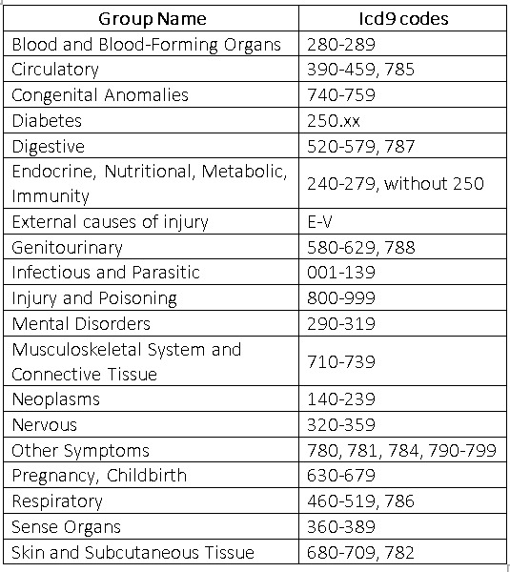
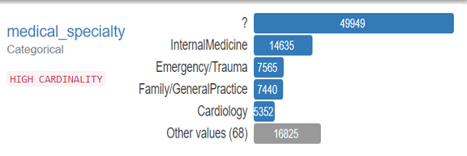
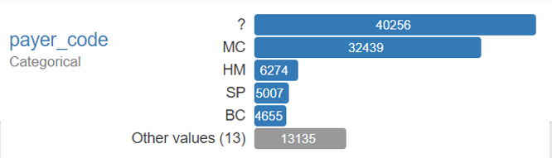
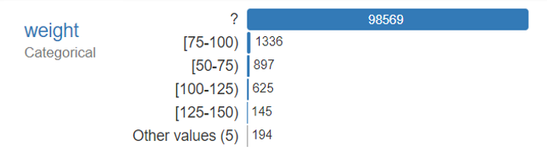
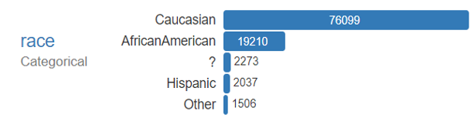
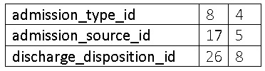
Pre-Processing Steps
Missing Values
Dropping rows and columns wherever necessary.
Merging multiple values in the columns giving similar inferences.
Combining Categories

Slide 8
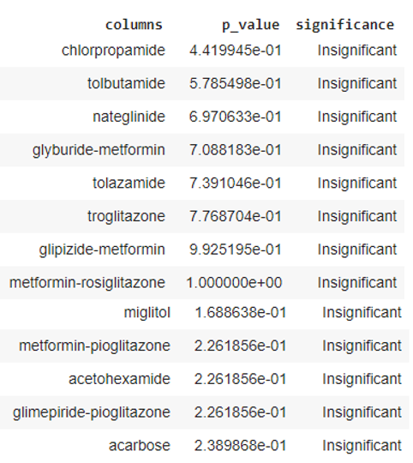
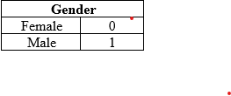

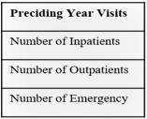


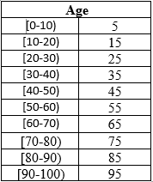

Data inconsistencies compromise data integrity and alter the performance of the algorithm.
Inconsistencies
Different encoding techniques used to encode categorical variables.
Encoding
Creating New Features and Dropping Redundant Ones.
Feature Engineering

Slide 9
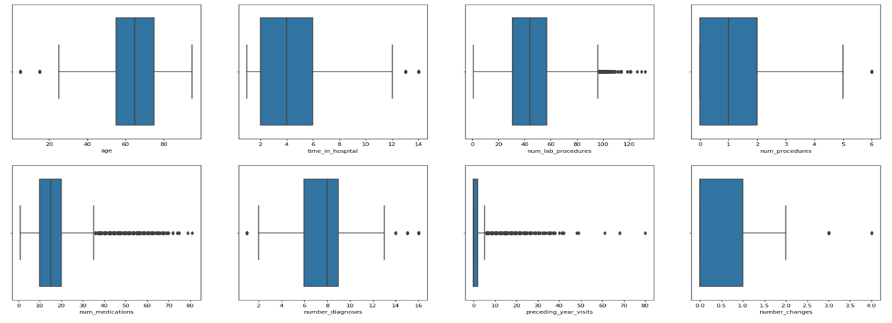
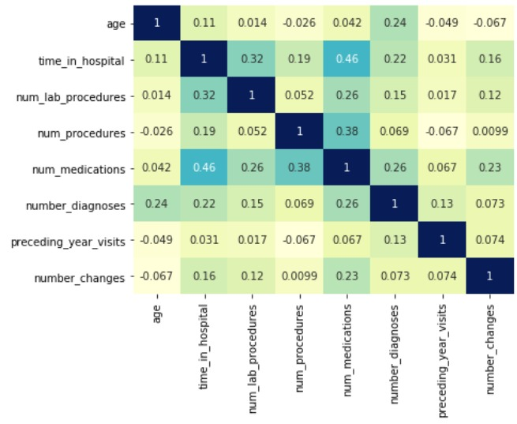
Fig xiii. Heat Map
Fig xii. Box Plots
Statistical Summary
We had 39 independent features out of which 31 were categorical and 8 were numerical. After statistical analysis :-
15 out of 31 categorical features came to be significant. (Chi-Square)
All 8 of the numerical features came to be significant. (ANOVA)

Slide 10
Baseline Model
Primary Evaluation Metric: Recall
We used tree based algorithm because Logistic Regression model suffers from limitations like linear relationship, outliers and multicollinearity.
Base Line Model Results (Random Forest) :-
Train Set Results
Confusion Matrix
Accuracy | F1-Score | Precision | Recall | ROC-AUC
0.999 | 0.999 | 1.000 | 0.999 | 0.999
61594 | 0
4 | 7912
Test Set Results
Accuracy | F1-Score | Precision | Recall | ROC-AUC
0.886 | 0.011 | 0.540 | 0.005 | 0.631
26381 | 17
3372 | 20

Slide 11
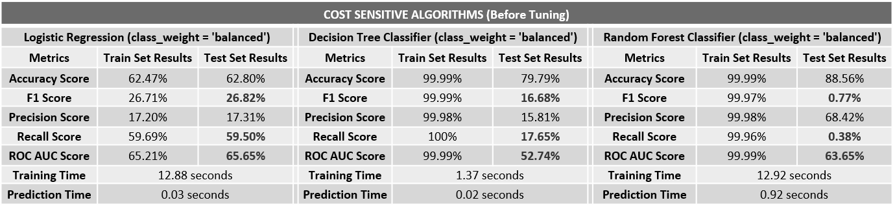
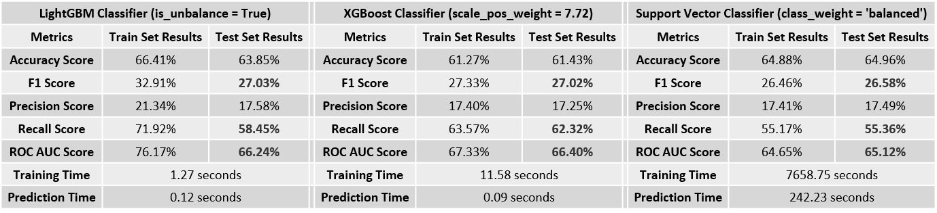
Modelling Results: Before Tuning

Slide 12
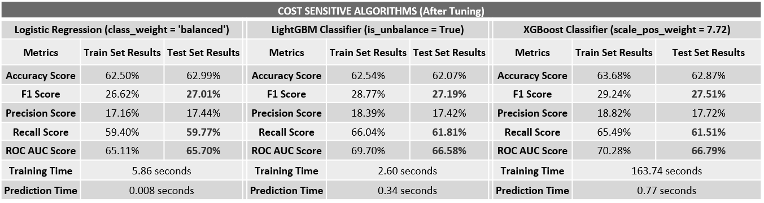
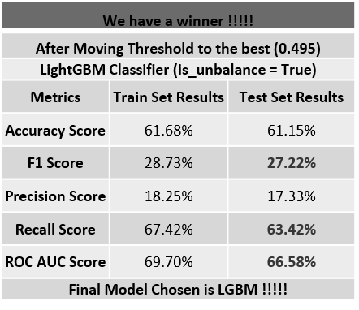
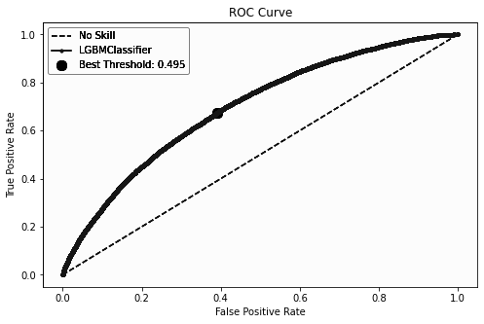
Modelling Results: After Tuning
Confusion Matrix:
15694 | 10091
1220 | 2116
A 95% likelihood of Recall between 59.7% and 63.4%.
Confidence Interval For Recall Score:

Slide 13
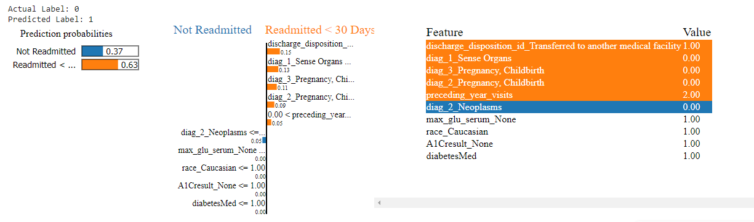
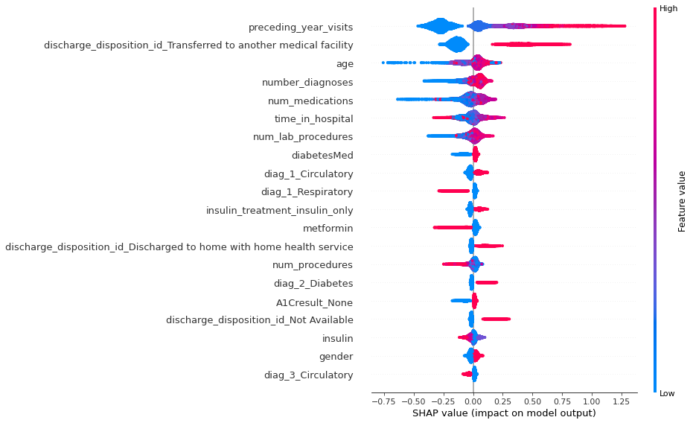
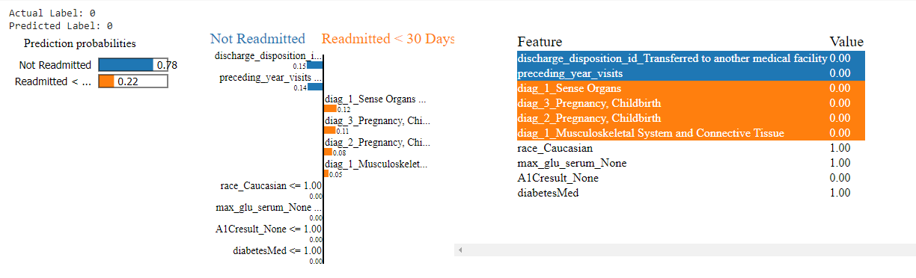
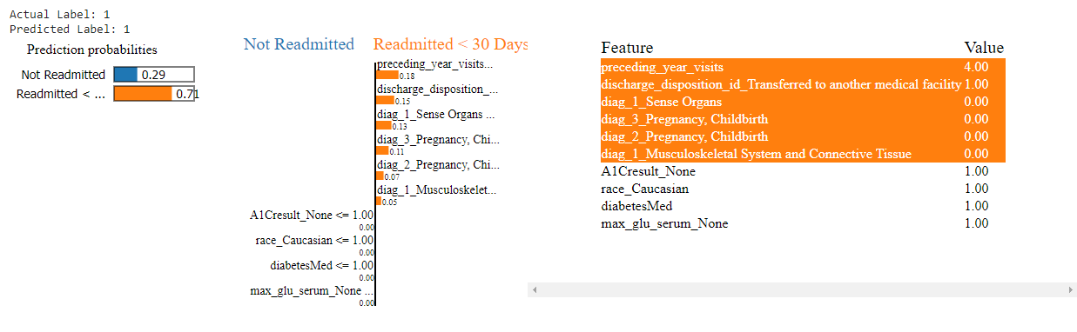
Model Interpretation
SHAP
(Shapley Additive Explanations) is a game theoretic approach to explain the output of any machine learning model. It connects optimal credit allocation with local explanation using the classic Shapley values from game theory and their related extensions.
SHAP
(Shapley Additive Explanations) is a game theoretic approach to explain the output of any machine learning model. It connects optimal credit allocation with local explanation using the classic Shapley values from game theory and their related extensions.

Slide 14
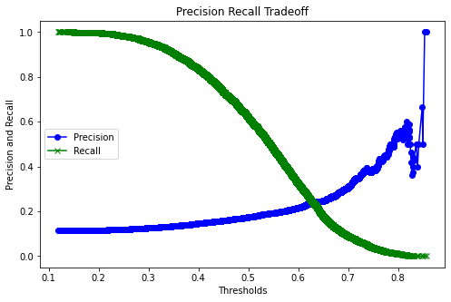
Findings
Challenges Encountered
If the patient has the following characteristics he has a high probability of being readmitted :
High preceding year visits.
If the patient is discharged to another medical facility or discharged to home with health services.
High number of diagnoses.
If the patient is given diabetes medicines.
If the primary diagnosed disease was of circulatory system.
If Metformin and/or insulin is not being given or the dosage is low.
If secondary diagnosis was coming to be Diabetes.
If A1C test was not performed.
The major challenge was to acquire sufficient domain knowledge of the medical world.
Computation time (Large Dataset) .
Class imbalance which would result in incorrect predictions.
Precision Recall Tradeoff.

Slide 15
Business Recommendation
Medical facilities can take precautionary measures with patients during their initial admission by making A1C and Maximum Glucose Serum test compulsory and providing the treatment accordingly.
A follow-up with the discharged patients should be done to keep a track of their health and to counsel them from time-to-time.
High-risk patients' current medicines' regime should be re-evaluated and the most effective medicines should be considered.
Most Effective Medicines :- Insulin, Metformin, Glipizide.
The annual plans, financials and infrastructure / inventory should be planned accordingly by taking into account the predicted readmissions.
Providing extra attention and care to high-risk patients.
Future Prospects and Suggestions
Bayesian Optimization, Neural Networks, One Class Classification, Probability Calibration, Stacking can be applied in the future to see improvements (if any).
Updating the diagnosis codes according to the ICD 11 standards.
Adding more observations for readmitted cases and collecting more data with respect to patient’s demography, lifestyle and mental health for a more informative dataset.

Slide 16
Thanks!
Submitted by-
Naveen Kumar Gupta
Shivam Saraogi
Arvind Sain
Guided by-
Mr. Koneti Naveen Kumar Yadav

